Slide 1
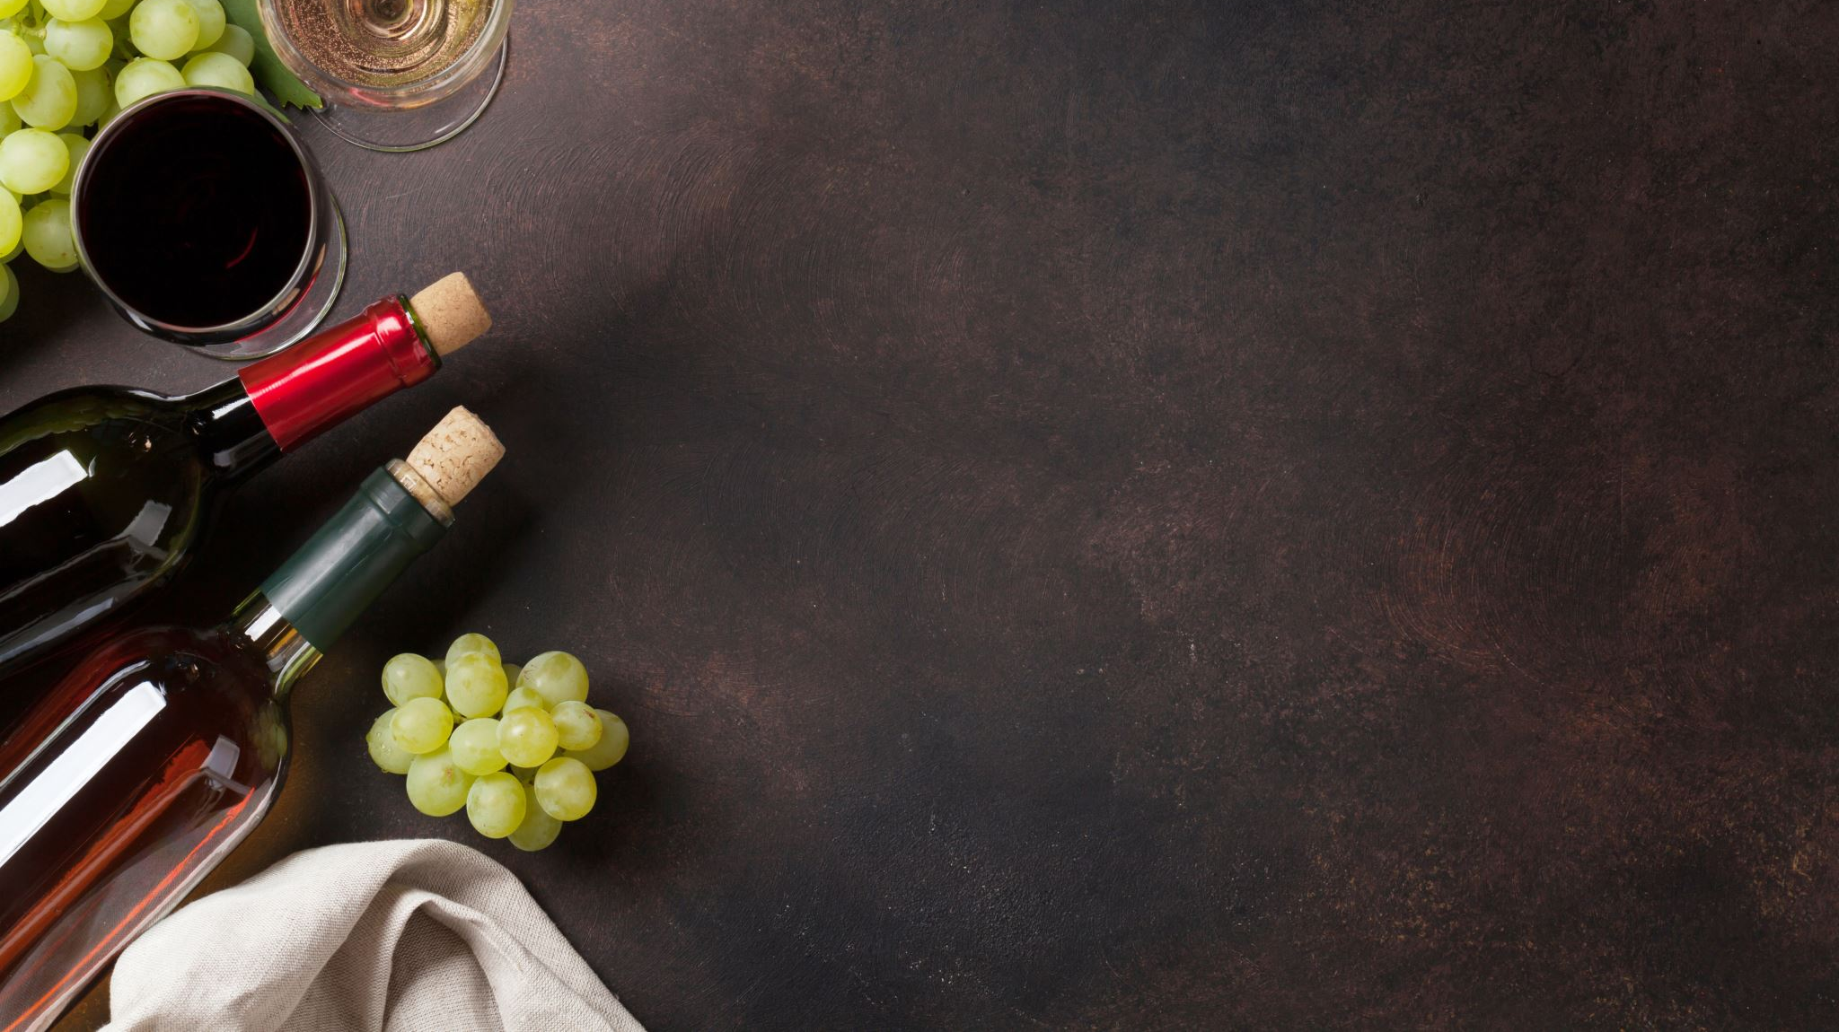
Classifying the Wine Quality with the Taste of Machine Learning Models
Created By: Sai Srujana Jakkala
Smita Karande

Slide 2


“Wine - Sounds simple yet has complex significance in the world. It is not just a glass of wine but creates friendships, memories, relationships, partnerships & much more”.
As said “Wine makes every meal an occasion, every table more elegant, every day more civilized.” — André Simon

Slide 3
Abstract
This project aims to classify wine quality based on its chemical compositions using machine learning models. Various algorithms like logistic regression, Random Forest, and support vector machines are evaluated for their performance. The goal is to help winemakers assess and ensure high-quality wine production efficiently.

Slide 4
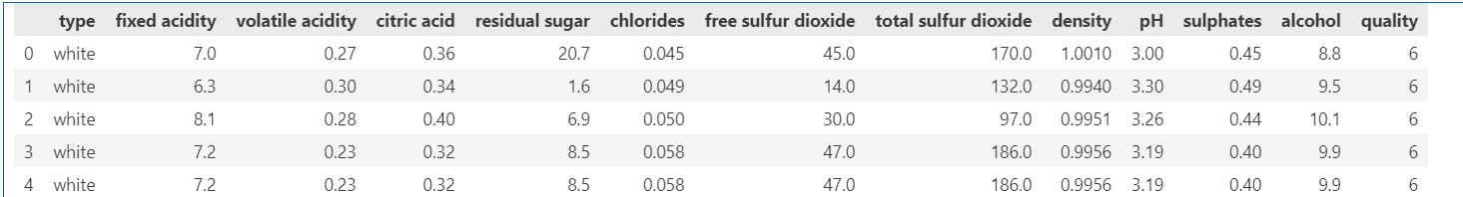
Methodology
The dataset is a merged data of two different variants red and white wines with new column added that classifies the wine variant
Data Overview:

Slide 5
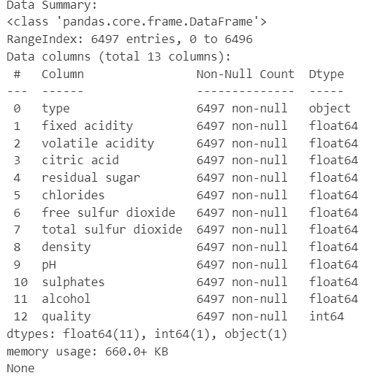
Features

Slide 6
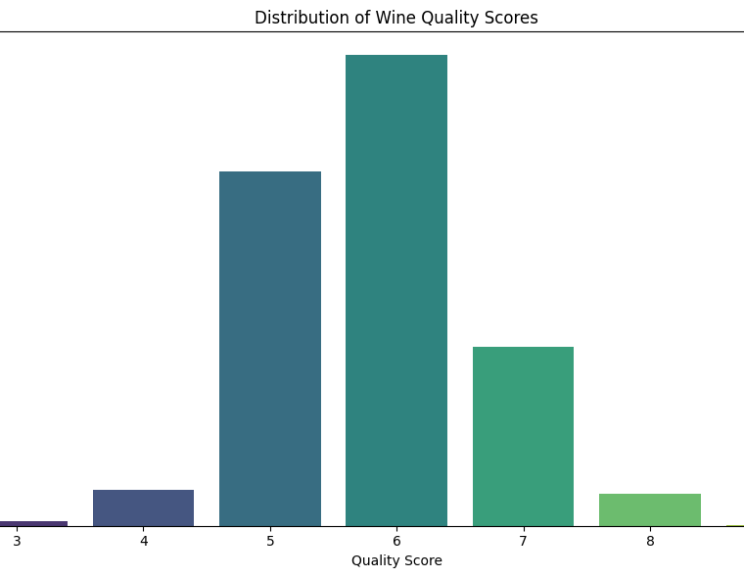
Wine Quality Score
Low: The low-quality wines range between 0 to 5
Medium: Medium quality range between 6 and 7
High: High quality of wine is between 8 to 10

Slide 7
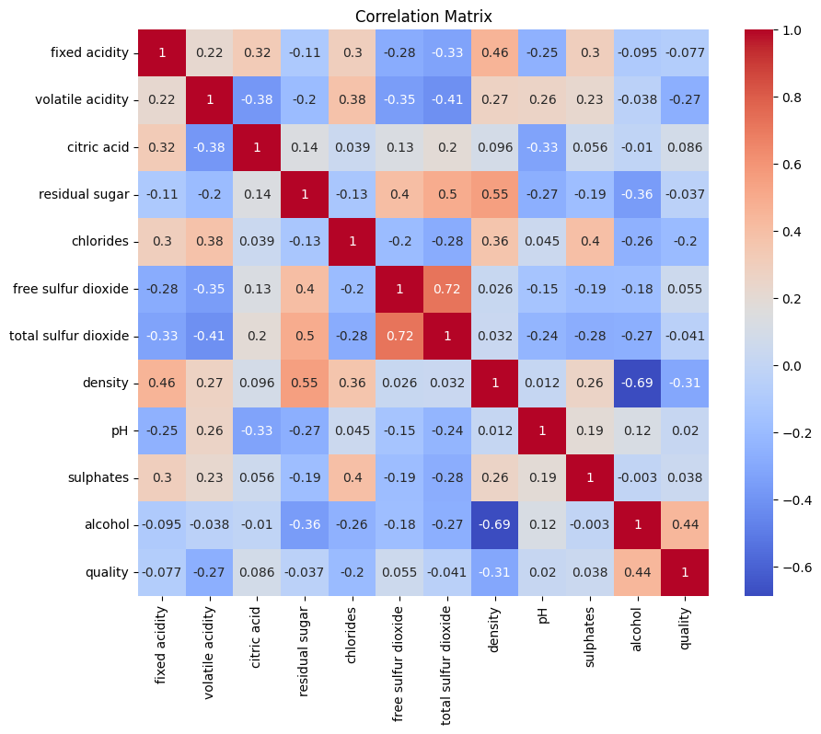
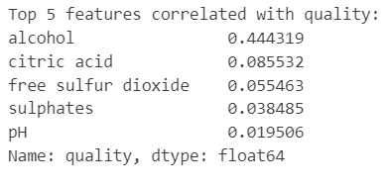
Exploratory Data Analysis
Exploratory Data Analysis (EDA) involves analyzing the dataset to identify key features impacting wine quality, such as alcohol content and density.

Slide 8
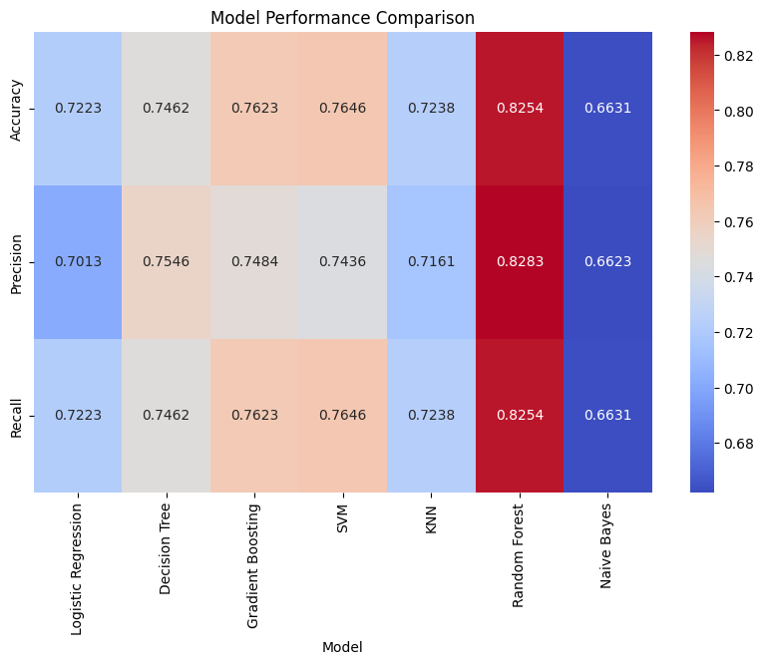
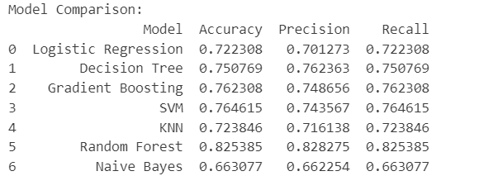
Model Training and Evaluation
Multiple classification models were used to predict the wine quality. This include simple and complex modelling techniques and performance was compared

Slide 9
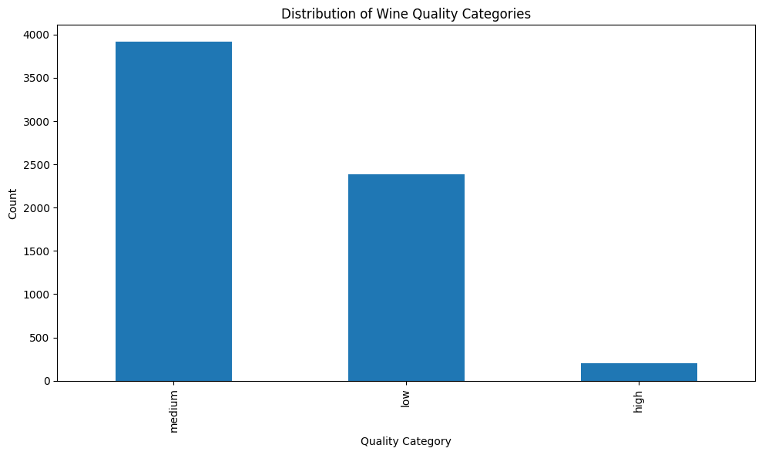
Distribution of Wine Quality Categories
The wine quality scores in the dataset are categorized into three distinct groups: low, medium, and high.
Low-quality wines have scores between 0 and 5
Medium-quality wines range from 6 to 7
High-quality wines score between 8 and 10.
The distribution shows that medium-quality wines are the most common, followed by low-quality wines, with high-quality wines being the least common.
This imbalance affects model performance, making it easier to predict medium-quality wines accurately.

Slide 10
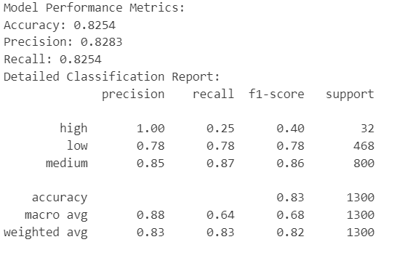
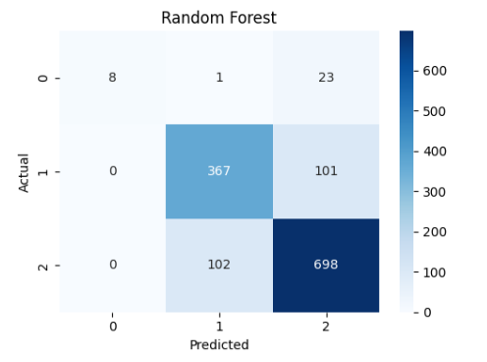
Model Performance & Results:
Confusion Matrix
Breakdown of the classification results, showing the counts of true positives, true negatives, false positives, and false negatives.

Slide 11
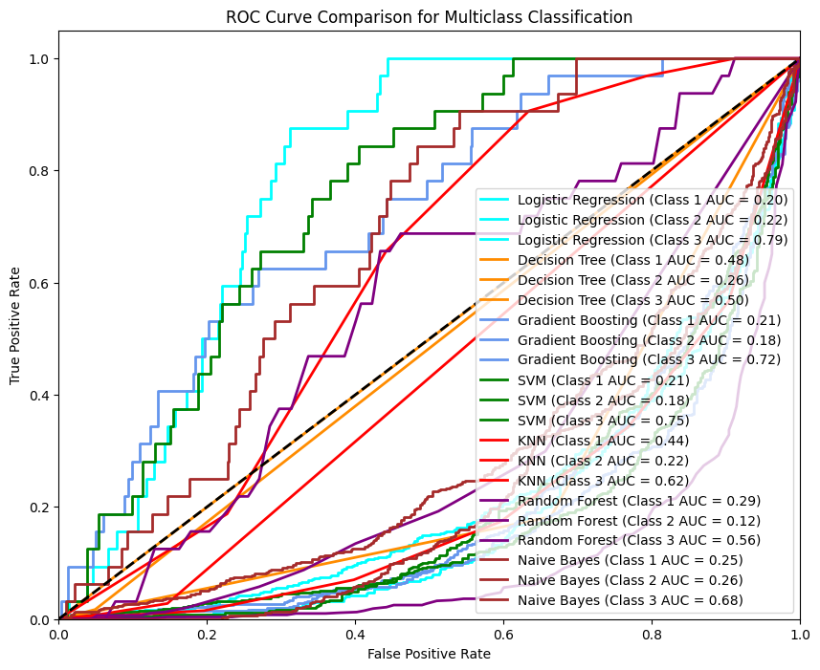
ROC Curve Comparision for Multiclass Classification
Class 1 (low): corresponds to wines with quality labeled as 'low' (quality ≤ 5). It refers to the low quality wines.
Class 2 (medium): corresponds to wines with quality labeled as 'medium' (quality between 6 and 7). It refers to the medium quality wines.
Class 3 (high): corresponds to wines with quality labeled as 'high' (quality > 7). It refers to the high quality wines.

Slide 12

Conclusion
In conclusion, we successfully applied multiple classification models to predict wine quality based on its chemical properties, achieving the highest accuracy of 83% with the Random Forest model.
Future work can focus on enhancing features and exploring advanced techniques to further improve prediction accuracy and assist wine producers in optimizing quality

